Slide 1
Connecting the MySQL database to Tableau Desktop and performing basic ETL
- Harsh Kondkar

Slide 2
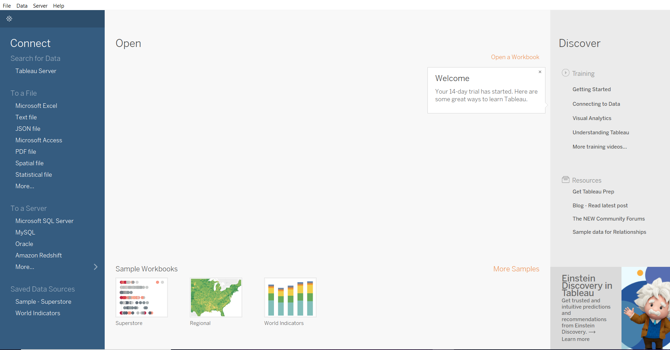
This is what the screen looks like when you first open up tableau Desktop.
As we now need to connect to our Sales database in MySQL we will do this by clicking on ‘MySQL’ in the ‘Connect’--→ ‘To a Server’ section.
Fill the necessary information about the server and the database and you are set to go

Slide 3
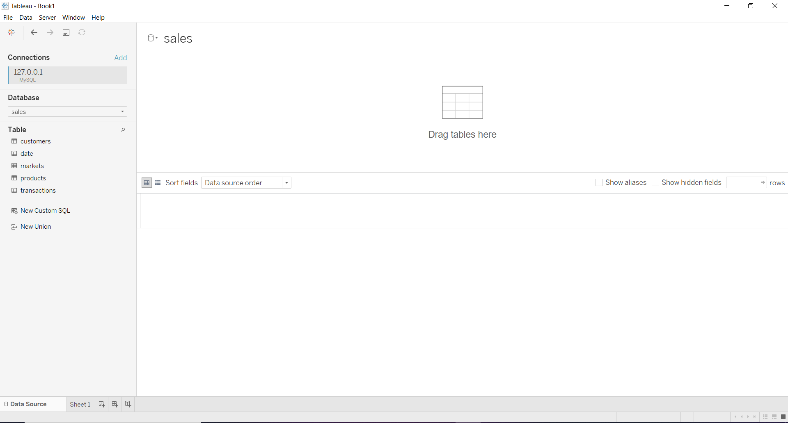
As we can see here that the database is connected and all the tables are available for further analysis.
We can drag the required table in the open area to view its contents.

Slide 4
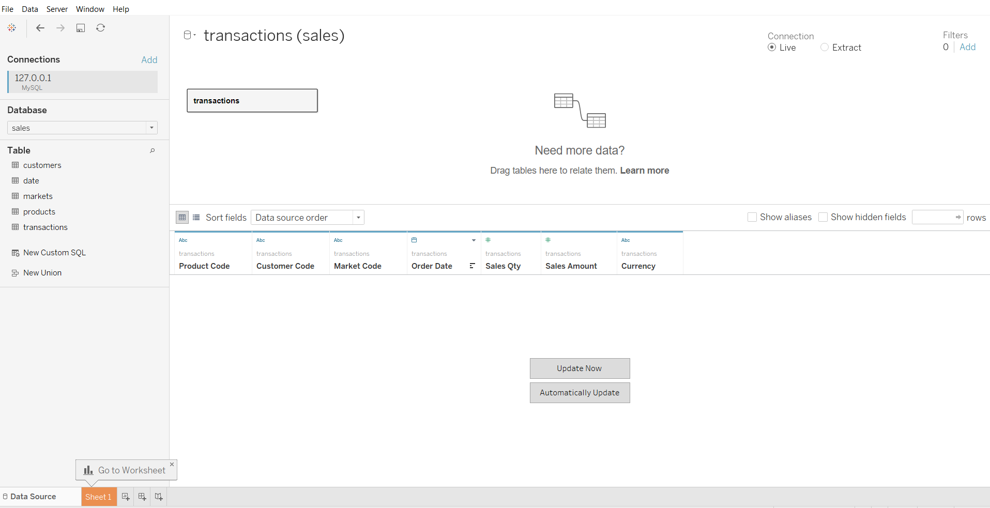
After dragging the table we can choose to automatically update which enables us to extract data from the database as and when it gets updated.
We can also specify the connection as ‘Live’ or ‘Extract’ depending on how often we want to get the updated data.

Slide 5
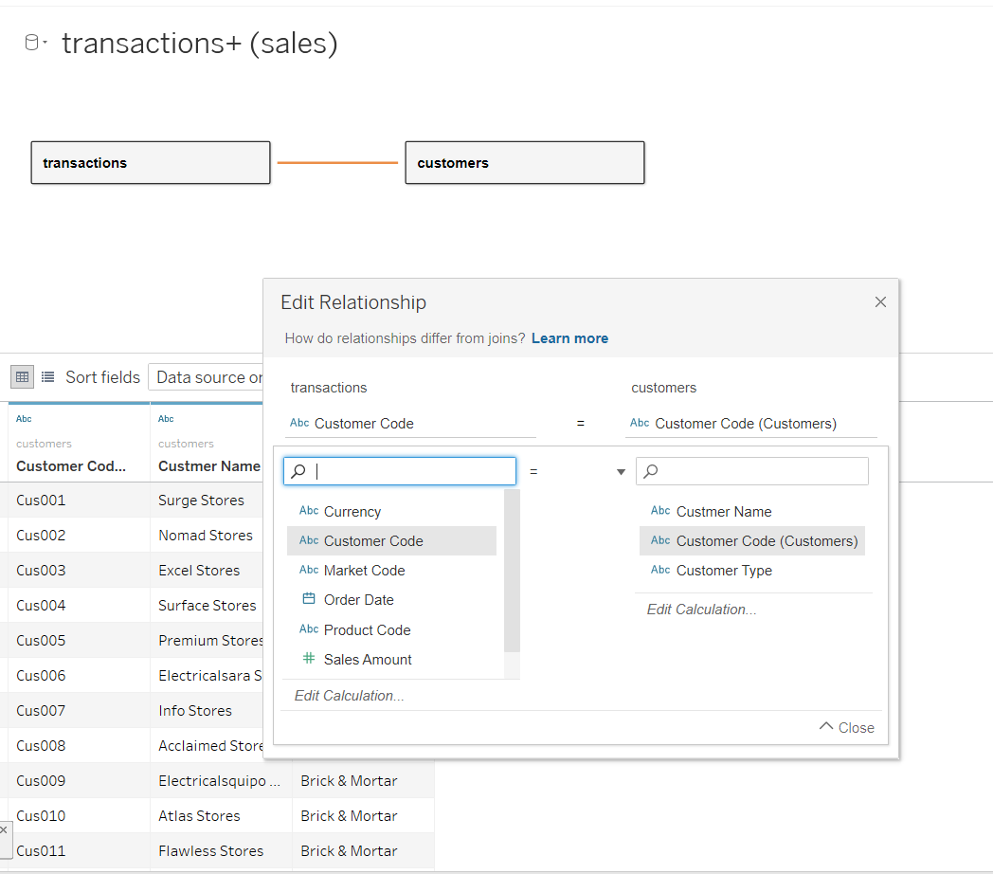
After dragging two tables in the space, a relationship is established between the two tables on the basis of the columns of our choice.
Relationships are basically a dynamic and flexible way to combine data from multiple tables and you do not need to specify the type like in joins, tableau does it for you ad hoc.

Slide 6
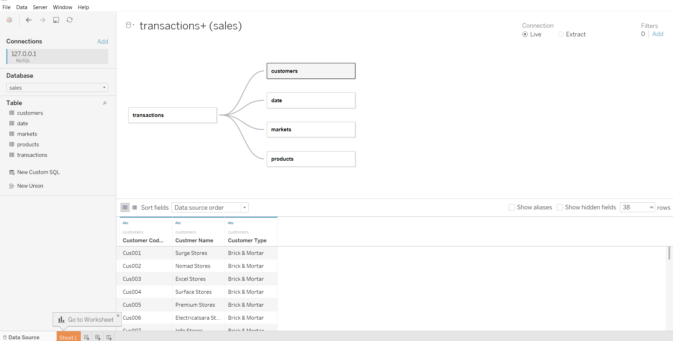
This is how our data model looks. The transactions table is connected to all the remaining tables using appropriate columns as keys.
It is also called as ‘Star Schema’.

Slide 7
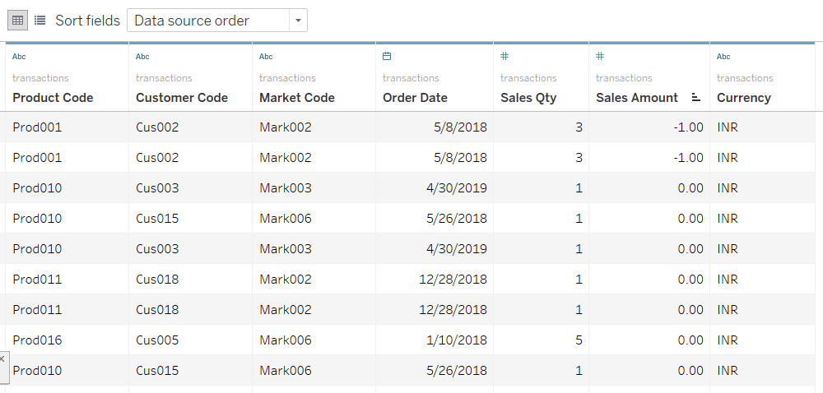
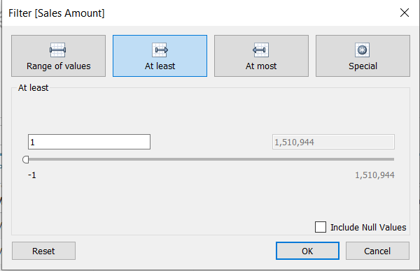
We see here that the sales amount is -1 and 0 which is clearly because of errors.
So we would like to do analysis on data where the sales amount is at least 1
This is done by selecting ‘Data’ in the menu bar and then choosing edit data source filters.
And then setting the ‘at least’ value to 1.

Slide 8
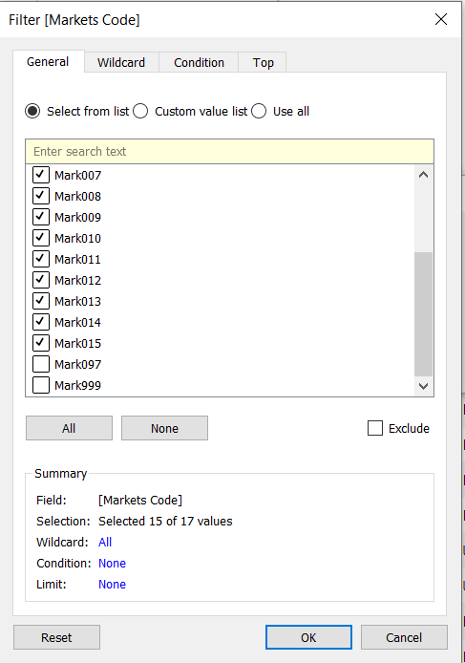
As we saw during our SQL querying that only two non-Indian markets existed namely Paris and New York.
These were special cases and should not be considered during analysis to see the bigger picture.
This can be dealt with a similar approach that we adapted while filtering the sales amount less than zero.
But this is discrete data so we will have to individually de select the market code corresponding to Paris and New York.

Slide 9
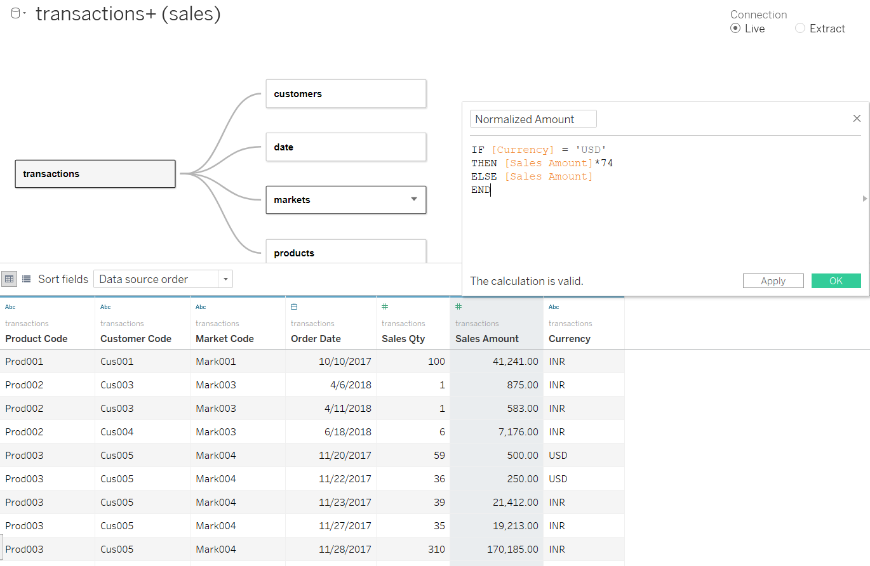
Another problem we face is that the currency is not consistent.
Few of the transactions have been done in US Dollars(USD).
Therefore, there is a need to create a new ‘normalized field’ where everything is in Indian Rupees(INR)
This is done using the concept of calculated field and the new column: ’Normalized Amount’ gives us the sales amount in INR at a 74 INR/USD conversion rate.

